Slide 1
REAL TIME FACE ATTENDANCE SYSTEM
KARTHICK ARAVIND B [211419104318]
T. PENIEL BRANHAM [211419104321]

Slide 2
ABSTRACT
Traditionally attendance is marked manually by teachers and they must make sure correct attendance is marked for respective student.
This whole process wastes some of lecture time and part of correct information is missed due to fraudulent and proxy cases.
Hence, we have proposed an automated student attendance system based on face recognition.
They keep track of student attendance and maintain them in the Excel File.

Slide 3
OBJECTIVES
The objective of this project is to develop face recognition based automated student attendance system.
This system emphasizes its simplicity by eliminating classical student attendance marking technique such as calling student names or checking respective identification cards.
Objectives are:
It detect the face segment from the video frame
It extract the useful features from the face detected.
It classify the features in order to recognize the face detected.
It record the attendance of the identified student.

Slide 4
EXISTING SYSTEM
The Existing fingerprint system is indeed effective but not efficient because it takes time for the verification process.
Voice recognition is available, but it is less accurate compared to other methods.
Iris recognition system which contains more detail. So, It is difficult to Implement

Slide 5

PROPOSED SYSTEM
The main task of our proposed system is to detect and recognize the image of the student and mark the attendance accordingly in the excel file.
After successful recognition of a student, the system automatically updates the attendance in the database.
The proposed system improves the performance of existing attendance management systems by eliminating manual calling.

Slide 6
SOFTWARE REQUIREMENT
Operating System Windows 10 SP1+,8, 64-bit version
Microsoft Visual Studio code
Anaconda prompt (miniconda3)
Programming Language: Python
Database: MySQL
OpenCV
Pillow
Pandas
NumPy

Slide 7
HARDWARE REQUIREMENT
2.3 GHz
8GB
32 GB
Processor
Memory (RAM)
Hard Disk

Slide 8
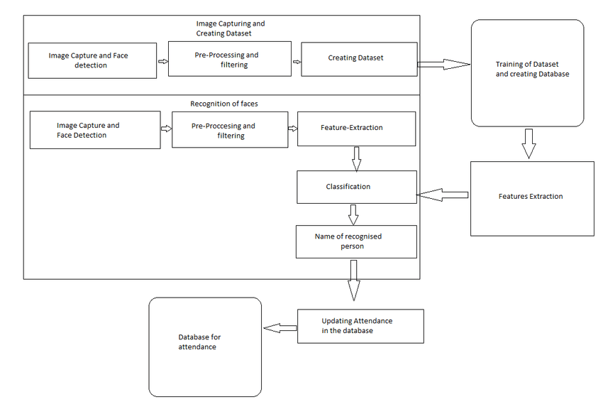
Architecture diagram for the Real Time Face Attendance System

Slide 9
Sample Screens
for Real Time Face Attendance System

Slide 10
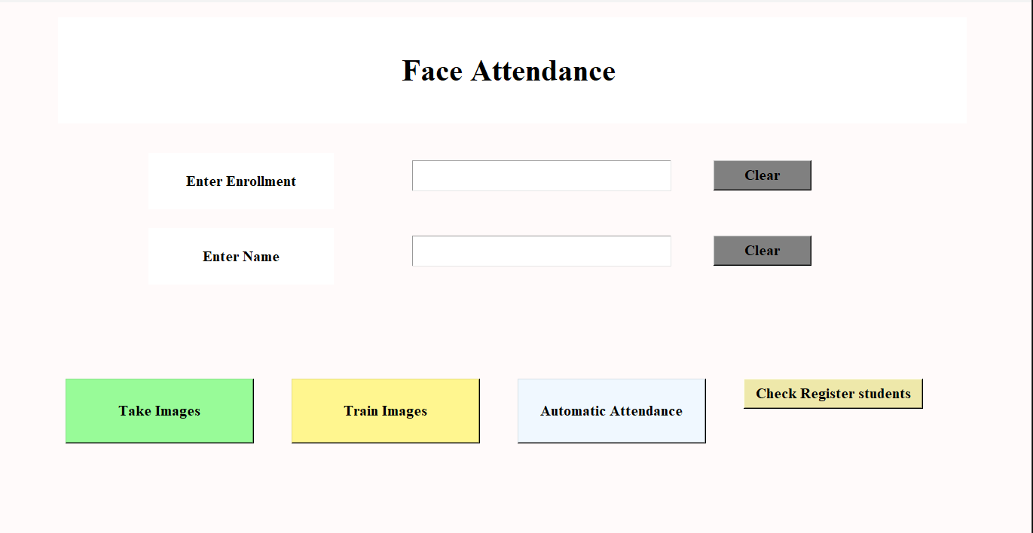
Starting window

Slide 11
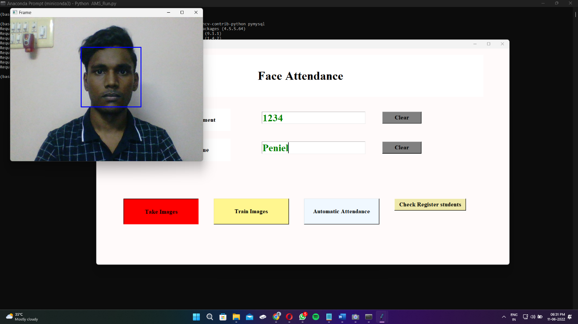
Register the Details to Capture the Student Face

Slide 12
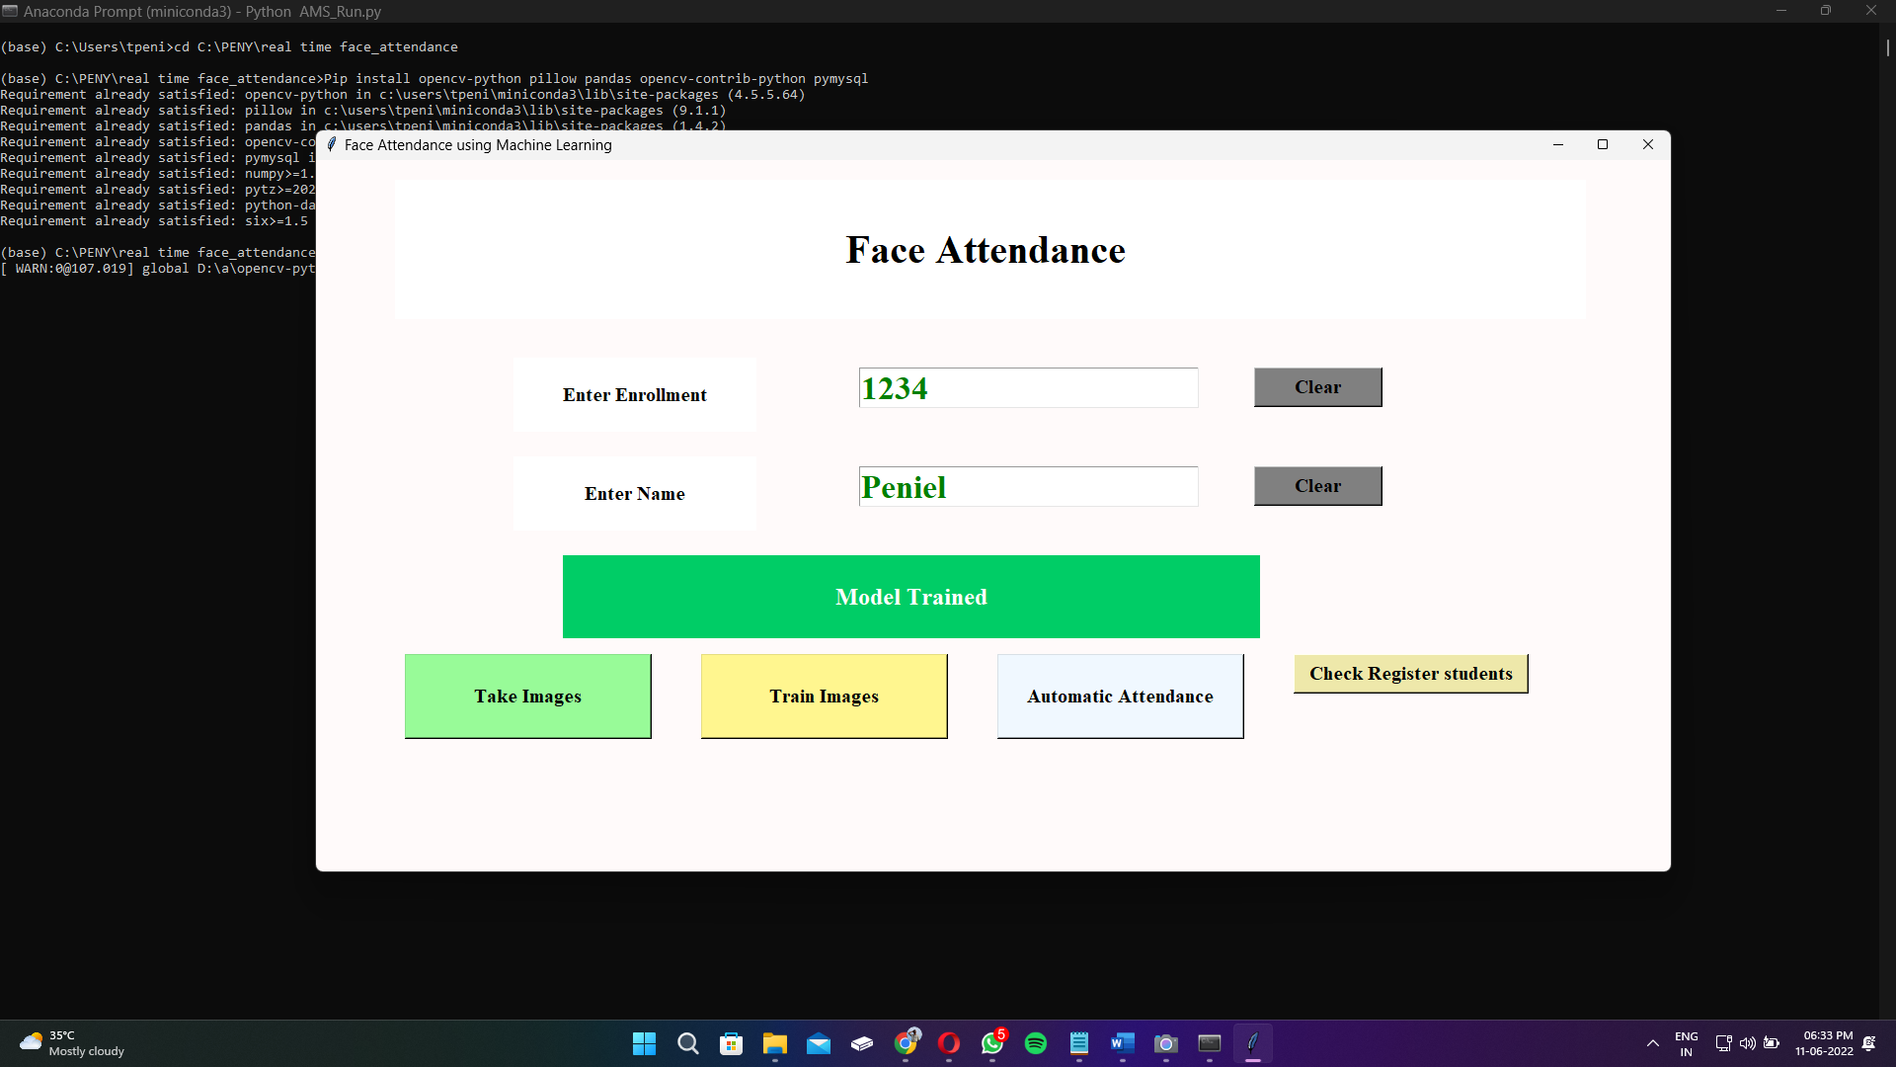
Student Face Trained

Slide 13
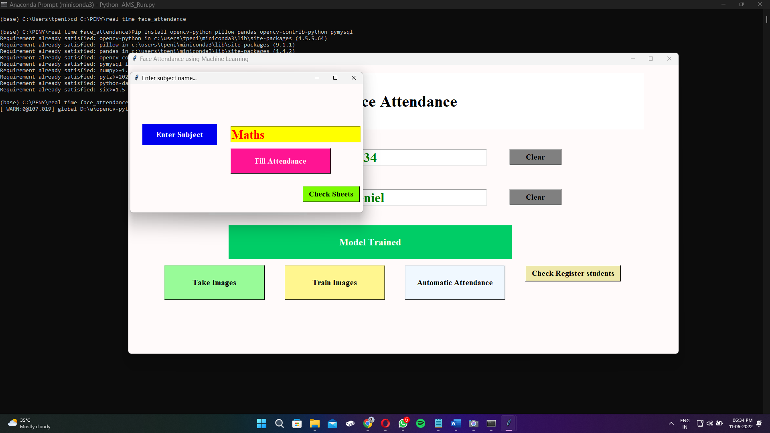
Enter the subject Details to Fill Attendance

Slide 14
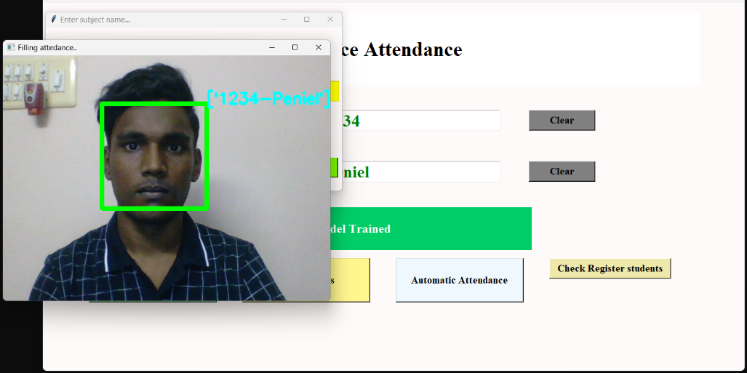
Student Face Identified

Slide 15
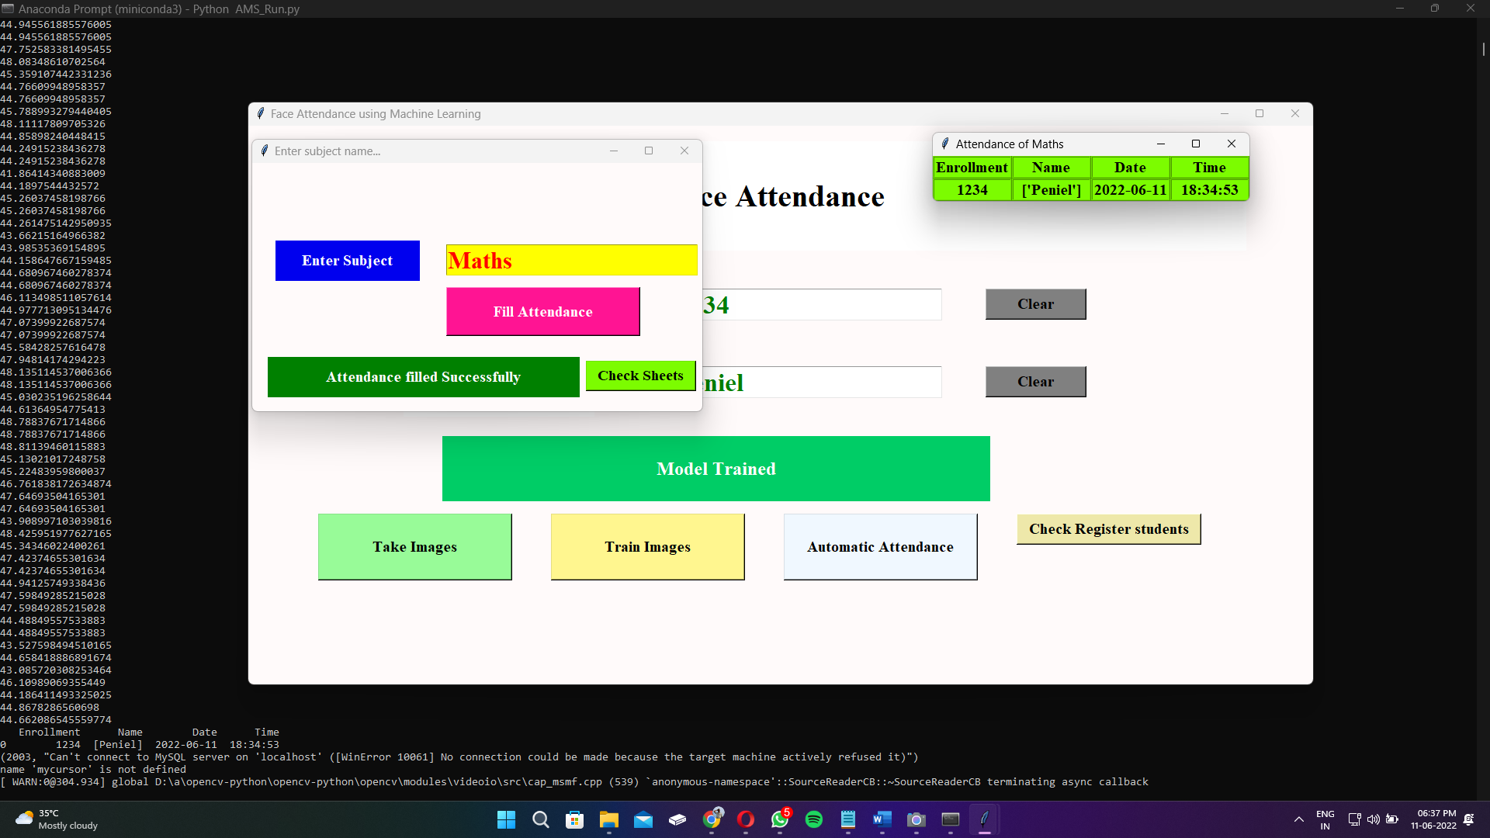
Attendance Filled Automatically

Slide 16
CONCLUSION
The proposed approach provides a method to identify the individuals by comparing their input image obtained from recording video frame with respect to train image.
The test images and training images have to be captured by using the same device to ensure no quality difference.
The enrolment can be done on the spot through the user-friendly interface.

Slide 17
REFERENCES
Robinson-Riegler, G., & Robinson-Riegler, B. (2008). Cognitive psychology: applying the science of the mind. Boston, Pearson/Allyn and Bacon.
Margaret Rouse. (2012). What is facial recognition? - Definition from WhatIs.com. [online] Available at: http://whatis.techtarget.com/definition/facial-recognition [Accessed 25 Mar. 2018].
Solon, O. (2017). Facial recognition database used by FBI is out of control, House committee hears. [online] the Guardian. Available at: https://www.theguardian.com/technology/2017/mar/27/us-facial-recognition- database-fbi-drivers-licenses-passports [Accessed 25 Mar. 2018].
Robert Silk. (2017). Biometrics: Facial recognition tech coming to an airport near you: Travel Weekly. [online] Available at: http://www.travelweekly.com/Travel-News/Airline-News/Biometrics-Facial- recognition-tech-coming-airport-near-you [Accessed 25 Mar. 2018].
Sidney Fussell. (2018). NEWS Facebook's New Face Recognition Features: What We Do (and Don't) Know. [online] Available at: https://gizmodo.com/facebooks-new-face-recognition-features-what-we-do-an- 1823359911 [Accessed 25 Mar. 2018].
deAgonia, M. (2017). Apple's Face ID [The iPhone X's facial recognition tech explained]. [online] Computerworld. Available at: https://www.computerworld.com/article/3235140/apple-ios/apples-face-id-the- iphone-xs-facial-recognition-tech-explained.html [Accessed 25 Mar. 2018].

Slide 18
THANKS!

